Slide 1

FIFA World Cup
2026™
Boston Fan Experience App
Explore matches, transportation, dining, lodging,
and fan experiences at Gillette Stadium, Foxborough MA.
· Athena Huang · Zoey Huang · Leanne Chung · Joe Wang · Carolyn Zeng · Sunny Guo
FIFA World Cup 2026 Boston · APAN 5310 SQL

Slide 2
MEET THE TEAM
🏠
Carolyn Zeng
🏟️
Sunny Guo
🚌
Joe Wang
Matches
Tickets
Transportation &
Boston Stadium
🍽️
Leanne Chung
🏨
Athena Huang
📊
Zoey Huang
Dining
Lodging
Players & Teams

Slide 3
TECH STACK & APPLICATION ARCHITECTURE
How It's Built
Frontend
R Shiny · renderUI() · fluidRow() · tabsetPanel() · uiOutput()
Mapping
Leaflet · addTiles() · addAwesomeMarkers() · layerId · marker_click events · Google Map API
Tables
DT::datatable() · formatStyle() · styleColorBar() · styleInterval() · dataTableProxy()
Charts
ggplot2 · geom_bar() · coord_polar() · coord_flip() · scale_fill_gradient()
Database
PostgreSQL (3NF) · dbGetQuery() · 8 normalized tables · Foreign keys
Reactivity
reactive() · invalidateLater(1000) · observeEvent() · reactiveVal() · updateSliderInput()

Slide 4

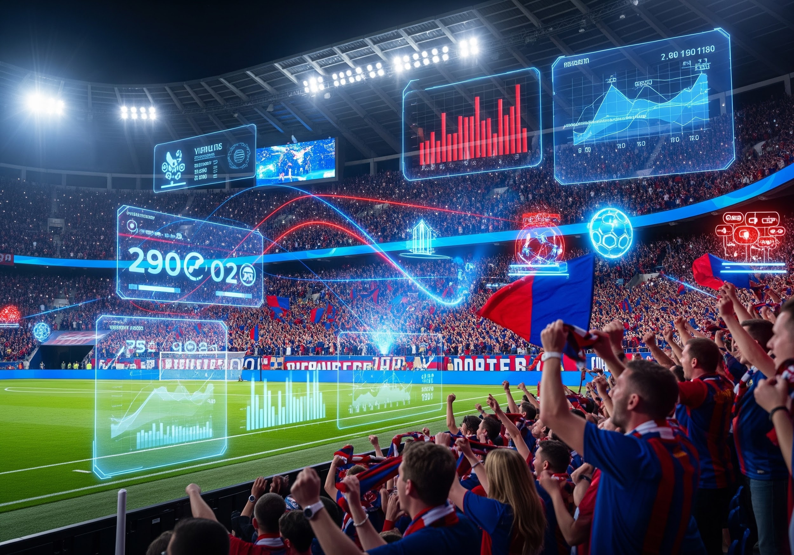
Strategic Context & Objective
The Problem & Solution
The Problem
Logistical Chaos for 1M+ Fans
· Disparate Data: Match schedules, transit, and lodging siloed across dozens of platforms.
· Infrastructure Strain: Mass influx to Gillette Stadium requires precise, real-time coordination.
The Solution
A Unified Fan Experience Hub
· Centralized ETL: Consolidates raw datasets into a single, high-performance PostgreSQL database.
· Reactive Interface: One-stop R Shiny app for real-time navigation and planning.

Slide 5
DATABASE SCHEMA
Fully normalized relational schema: ETL from raw datasets → PostgreSQL
matches
teams
players
ticket_pricing
players
match_id, match_number, round_number, match_datetime, location, home_team, away_team, group_name, result
team_id, team_name
player_id, player_name, team_id, club_id, position, date_of_birth, goals
pricing_id, round_name, category_id, ticket_categories, capacity, price_usd_min, price_usd_max
gillette_restaurants
stays
clubs
stadium_sections
clubs
rest_id, title, category, stars, miles_from_stadium, latitude, longitude, address
stay_id, title, category, lat, lng, stars, miles_to_stadium
club_id, club_name
section_id, section_name, level_name, zone, category_id
transport_routes
route_segments
ticket_categories
route_id, route_name, primary_mode, origin_hub, destination_hub, est_total_time_min, fare_text, matchday_only, reservation_required
segment_id, route_id, segment_order, from_point, to_point, mode, line_name, operator, est_time_min
category_id, category_name, description

Slide 6
FEATURES
Match Participants, Dates & Times
Matches tab
★ Live Countdown Timer
7 match cards — home/away teams, kickoff time,
group, round, countdown, add-to-calendar link
Ticks every second via invalidateLater(1000)
showing days/hours/minutes/seconds to kickoff
★ Interactive Leaflet Maps
Ticketing Options
Stadium tab
Dining & Lodging: pin-click opens detail
panel with Google Maps deep-link
Interacting pricing that maps stadium sections to predicted cost tiers that allows users to filter seating based on match round, view quality, and budget.
★ Player & Team Explorer
Filter by team/position, ggplot2 donut &
bar charts, top-scorer spotlight
Travel, Lodging & Dining Planning
Multiple tabs
Transport routes with step-by-step directions
+ Lodging map + Dining filter & map
★ Transport Route Embed
Live Google Maps Directions iframe per
route — step-by-step segments table

Slide 7









APPLICATION
Home
Matches
Dining
Lodging
Hero banner · countdown timer · 5 match preview cards
7 match cards · kickoff countdown · group/round · calendar
Leaflet map · filter by distance · stars & cuisine
Hotels near Gillette · filter by distance & stars
Transport
Stadium
Players
About
Route selector · step-by-step · live Maps embed
Gillette guide · checklist · about the venue
Full roster · filter & search · ggplot2 charts
Team profiles · background · APAN 5310
Ticketing
Interactive pricing maps · section explorer · FIFA link

Slide 8
HOME TAB · HERO BANNER + LIVE COUNTDOWN
Countdown to Boston's First Match
Group Stage Matches — Boston
Haiti vs Scotland · June 13, 2026 · 9:00 PM ET
Gillette Stadium, Foxborough MA
Haiti vs Scotland
Group H
Gillette Stadium · Jun 13, 2026
46
00
00
00
France vs Morocco
Group E
Gillette Stadium · Jun 16, 2026
Days
Hours
Mins
Secs
Scotland vs Iraq
Group H
invalidateLater(1000, session) → reactive countdown
updates Days / Hours / Minutes / Seconds every second
Gillette Stadium · Jun 20, 2026
Norway vs England
Group F
Gillette Stadium · Jun 23, 2026
Morocco vs Haiti
Group E
Gillette Stadium · Jun 26, 2026

Slide 9
TICKETING TAB · OFFICIAL FIFA WORLD CUP 2026 CATEGORIES
Select Match Round: Group Stage
Haiti vs Scotland · Iraq vs Norway · Scotland vs Morocco · England vs Ghana · Norway vs France
BEST VALUE
Cat 1
Prime seating along the sidelines
Est. price range
$250 – $450
Avail: ~1,200
Cat 2
Excellent views from corners/lower ends
Est. price range
$180 – $320
Avail: ~2,500
Cat 3
Standard seating in the upper tiers
Est. price range
$95 – $175
Avail: ~4,800
Cat 4
Budget-friendly goalside seating
Est. price range
$55 – $110
Avail: ~3,100
Access
Dedicated accessibility platforms
Est. price range
$55 – $95
Avail: ~450
Buy Official Tickets on FIFA.com
SQL: SELECT tc.category_name, tc.description, tp.round_name, tp.tickets_available, tp.price_usd_min, tp.price_usd_max FROM ticket_pricing tp JOIN ticket_categories tc ON tp.category_id = tc.category_id ORDER BY tp.round_name, tp.category_id

Slide 10
MATCHES TAB
boston_matches_data()
Match 1
Match 2
Match 3
Match 4
Haiti vs Scotland
France vs Morocco
Scotland vs Iraq
Norway vs England
Group H
Group E
Group H
Group F
Jun 13 9:00 PM
Jun 16 6:00 PM
Jun 20 9:00 PM
Jun 23 9:00 PM
📅 Add to calendar
📅 Add to calendar
📅 Add to calendar
📅 Add to calendar
Match 5
Match 6
Match 7
Morocco vs Haiti
Round of 32
Quarterfinal
Group E
Knockout
Knockout
Jun 26 6:00 PM
TBD
TBD
📅 Add to calendar
📅 Add to calendar
📅 Add to calendar
SQL: SELECT * FROM matches WHERE location = 'Boston Stadium' ORDER BY match_id

Slide 11
TRANSPORT & LODGING · GETTING THERE + STAYING NEARBY
🚌 Transportation
🏨 Lodging
Route Selector:
Select Route ▾
Category ▾
Max Distance ◀▶
Origin:
e.g. South Station, Boston
🗺 Leaflet Map
Destination:
Gillette Stadium, Foxborough
Red pin = Gillette Stadium
Blue markers = hotels & stays
Popup: name + star rating
Time:
~55 min
Fare:
~$12–18
Matchday Only:
Yes
📋 DT::datatable
Reservation:
Not required
Columns: title, category, stars, miles_to_stadium
star → gold color-bar via formatStyle()
Rows sortable & paginated
📍 Live Google Maps Directions iframe
(transit mode, updates per selected route)
SQL: SELECT * FROM transport_routes ORDER BY display_order
SQL: SELECT stay_id, title, category, lat, lng, stars, miles_to_stadium FROM stays ORDER BY miles_to_stadium ASC

Slide 12
DINING TAB · GILLETTE STADIUM RESTAURANTS
52
4.2 ★
0.15 mi
Total Restaurants
Avg Star Rating
Closest Restaurant
Filters:
Cuisine ▾
Max Distance (mi) ◀▶
Min Stars ◀▶
Reset Filters
🗺 Leaflet Map
📋 DT::datatable
• Red pin = Gillette Stadium
• Navy pins = restaurants (addAwesomeMarkers)
• Click pin → detail panel + Google Maps link
Stars → gold color-bar
Distance → green/orange/red
PageLength 10, scrollX
SQL: SELECT rest_id, title, category, stars, miles_from_stadium, latitude, longitude, address FROM gillette_restaurants ORDER BY miles_from_stadium ASC

Slide 13
PLAYERS & TEAMS TAB · ROSTER EXPLORER + CHARTS
200+
10
80+
300+
Total Players
National Teams
Clubs
Combined Goals
🏆
Top Scorer Spotlight
[Player Name] · [Team] · [Club] · [N] goals — dynamically from DB via which.max()
Player Table
Team Overview
Position Breakdown
DT datatable
ggplot2 Charts
Donut + Scorers
Filter by Team / Position / Search
datatable dom='tip'
PageLength 15, scrollX, autoWidth
• Goals by Team (geom_bar, navy gradient)
• Squad Size (green gradient)
• Team roster detail table
• coord_polar position donut
FW / MF / DF / GK
• Top 10 scorer bar (scale_fill_brewer)
SQL: SELECT p.*, t.team_name, c.club_name FROM players p JOIN clubs c ON p.club_id=c.club_id JOIN teams t ON p.team_id=t.team_id ORDER BY t.team_name, p.goals DESC

Slide 14
FAN EXPERIENCE TAB · EVENTS & LOCAL ATTRACTIONS
FREE ENTRY
TICKETED
FREE
FIFA World Cup Fan Zone
France vs Morocco Watch Party
Scotland vs Iraq Fan March
City Hall Plaza. Live screening, food vendors, and FIFA activations. Opens Jun 13.
TD Garden big screen viewing. Doors open at 4:30 PM ET on June 16. Tickets from $25.
Jun 20. March from Kenmore Sq to Fenway with bagpipes and drums at 5:00 PM.
🏙️ TOP ATTRACTIONS
🦞 Quincy Market
Downtown foodie hub. 30 min from stadium.
⚾ Fenway Park Tour
Historic ballpark. 35 min from stadium.
🎨 Museum of Fine Arts
Global art collection. 40 min from stadium.
🏛️ Freedom Trail
2.5-mile historic walk. 30 min from stadium.
📍 Leaflet Map Logic: Markers at City Hall Plaza (Fan Zone), TD Garden (Watch Party), Kenmore Sq (March), and all attraction lat/lng coordinates.
SQL: SELECT * FROM fan_events UNION SELECT * FROM fan_attractions WHERE dist_to_stadium < 1.0 OR type='Iconic' ORDER BY date ASC

Slide 15
Thank You for Listening
Any Questions?

